Slide 1

Reusing Logic Across Platforms
Kevin Ford
Mobile Practice Lead
Magenic
Level: Intermediate

Slide 2
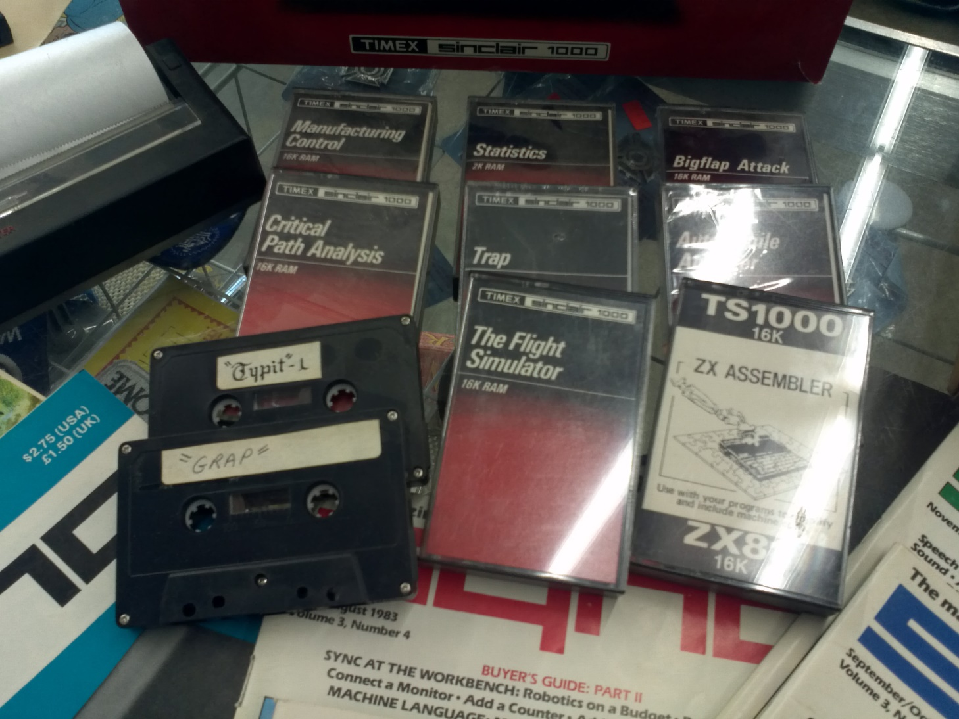
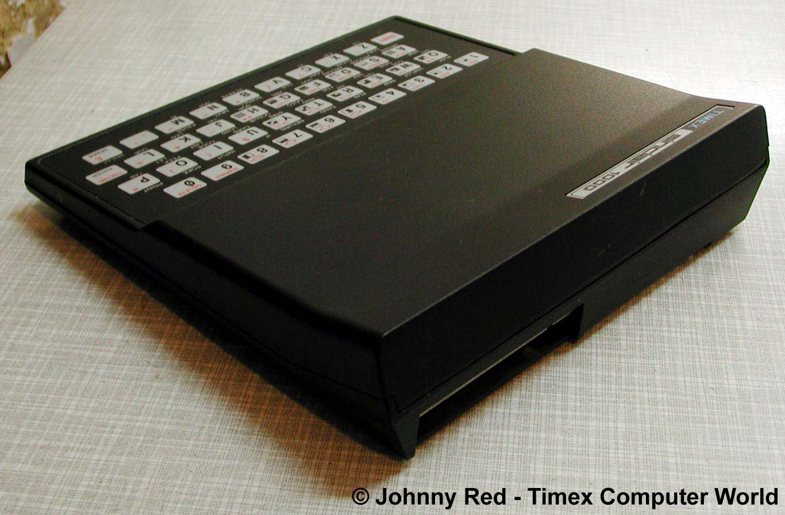
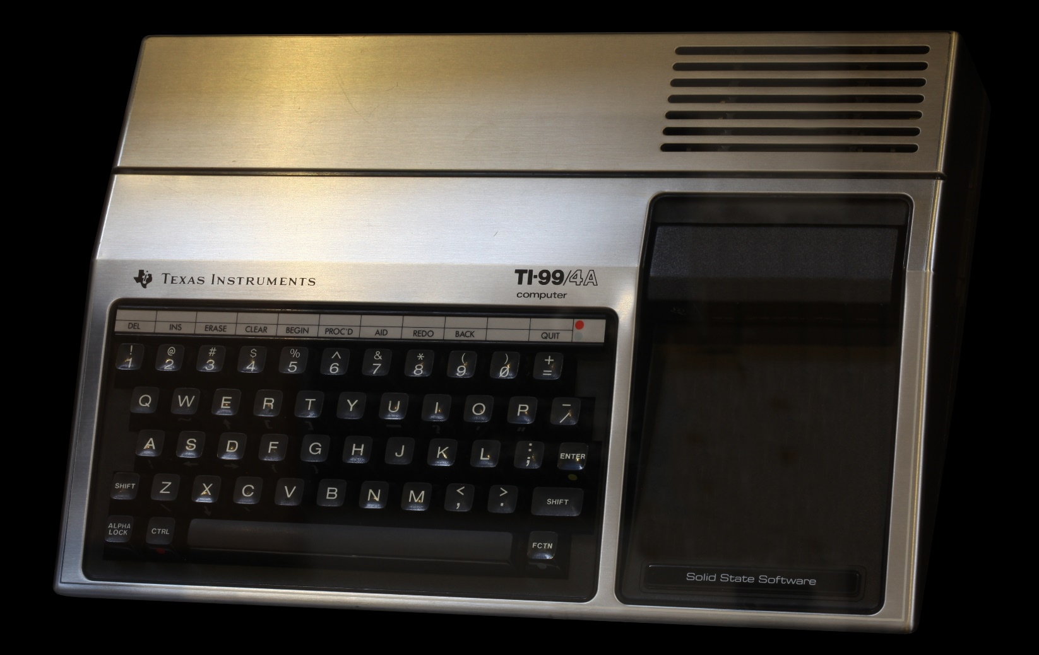
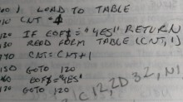

Slide 3
Thoughts for Today
Why is it important
Mechanics of code sharing in .Net
Roll of Frameworks

Slide 4
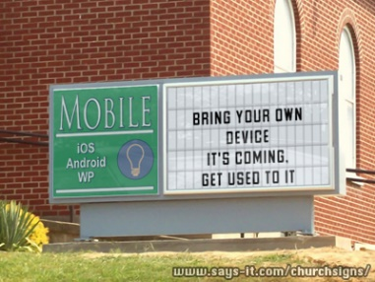
Number of workers using their own device by 2018: 70%

Slide 5


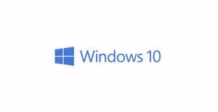
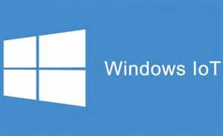


Platforms

Slide 6
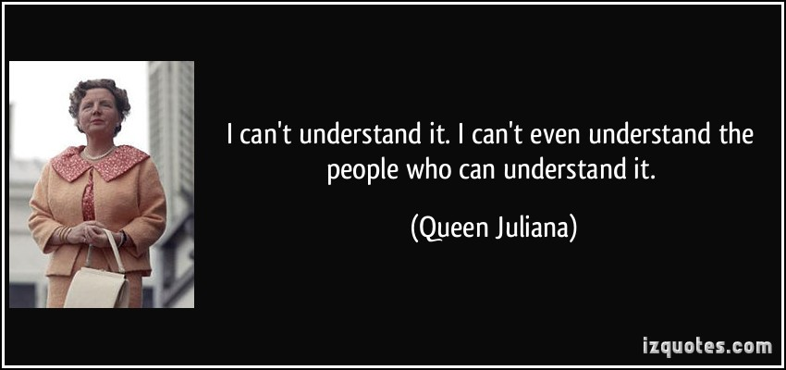
Languages?

Slide 7

User Expectations

Slide 8
Complexity
Making a very complex architecture to share code that would be easy to maintain on more than one platform is not a win
Inheritance models five levels deep to share a few lines of code in each level is not a win
Balance avoiding tight coupling with being able to understand the code
Sharing code is not the goal, the goal is maintainability
Notes:
Making a very complex architecture to share code that would be easy to maintain on more than one platform is not a win.
Inheritance models five levels deep to share a few lines of code in each level is not a win.

Slide 9




Application Architecture
HTML 5 UI
iOS UI
Windows Universal
Android UI
JavaScript BL
BL
BL
BL
Service Proxy
Data Portal
Data Portal
Data Portal
Reports
SQL Reporting
REST API
Data Portal
ASP.NET WA
BL
Excel
DAL
PowerPivot
SQL Database
Blobs

Slide 10
Sharing Opportunities
Interface
HTML, XAML (Forms)
Interface Logic
MVVM Cross
Business Logic
CSLA
Data Access
ORMs (EF)
Data
None

Slide 11
File Linking
Android App
iOS App
UWP App
Android Class Library
iOS Class Library
UWP Class Library
Code.cs
Code.cs
Code.cs

Slide 12
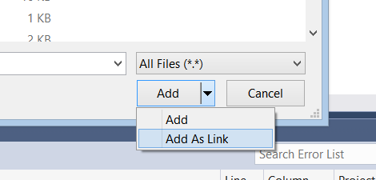
Adding a Linked File

Slide 13
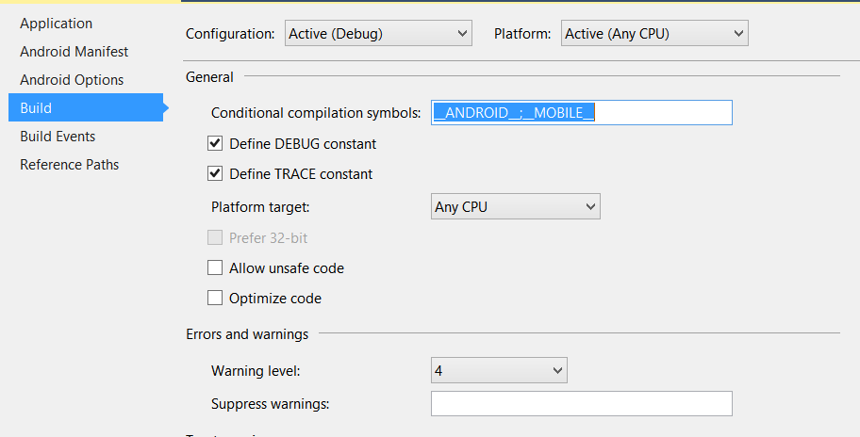
Conditional Compilation
#if __ANDROID__
request.ContentLength = uploadViewModel.PictureStream.Length;
#elif !WINDOWS_PHONE_APP && !WINDOWS_APP
request.Headers["Content-Length"] = uploadViewModel.PictureStream.Length.ToString();
#endif

Slide 14
Partial Classes
Xamarin Android
Xamarin iOS
Windows UWP
Timer Class
Timer Class
Timer Class
Timer Class

Slide 15
Partial Classes
In shared class file
public partial class Timer
{
public Timer()
{
// do stuff
ShowTime();
// do more stuff
}
}
In Android only class file
public partial class Timer
{
public void ShowTime()
{
Toast.MakeText (this, currentTime, ToastLength.Long).Show();
}
}

Slide 16
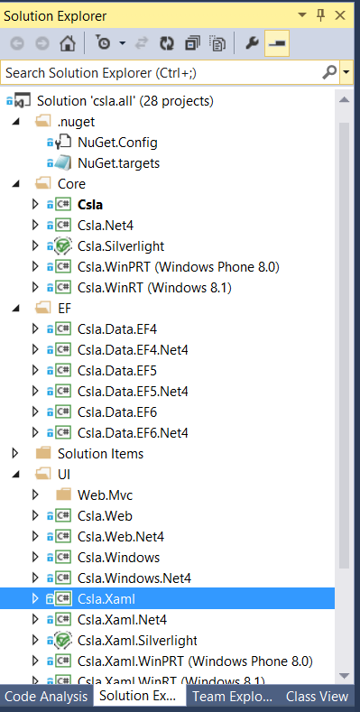

Problems?

Slide 17
Shared Projects
Android App
iOS App
UWP App
Shared Universal Project
Code.cs
Code.cs
Code.cs

Slide 18
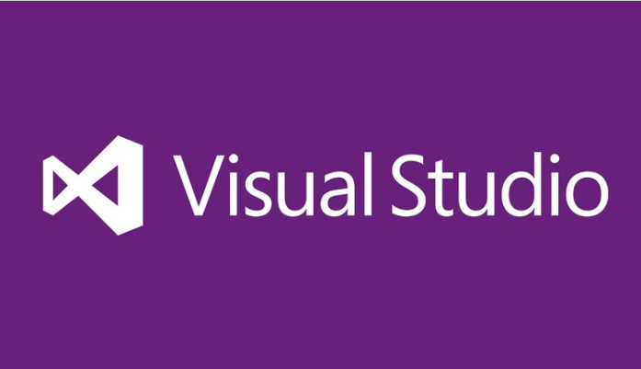
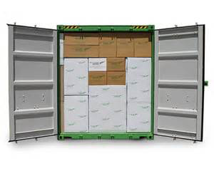
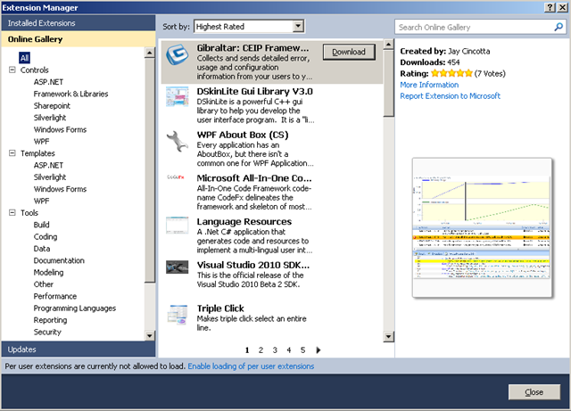

Shared Projects

Slide 19
Taking a Look at Shared Projects

Slide 20
PCL
Android App
iOS App
UWP App
Portable Class Library
Code.cs
Code.cs
Code.cs

Slide 21

PCL Limitations
Notes:
No platform specific code
Only code available for all platforms
Can only reference other PCLs or a compatible profile
Limited number of profiles (drag along platforms)

Slide 22
Platform Specific Code - IoC
Platform specific registration
Xamarin iOS DLL
PCL
Interface
Xamarin Android DLL

Slide 23
Platform Specific Code – Abstract Classes
In PCL
public abstract class MyBaseClass
{
public void DoGeneralFunction()
{
this.PlatformCommand();
}
protected abstract void PlatformCommand();
}
In platform specific class file
public class PlatformClass : MyBaseClass
{
protected override void PlatformCommand()
{
//Do platform specific commands
}
}

Slide 24
Taking a Look at PCLs

Slide 25
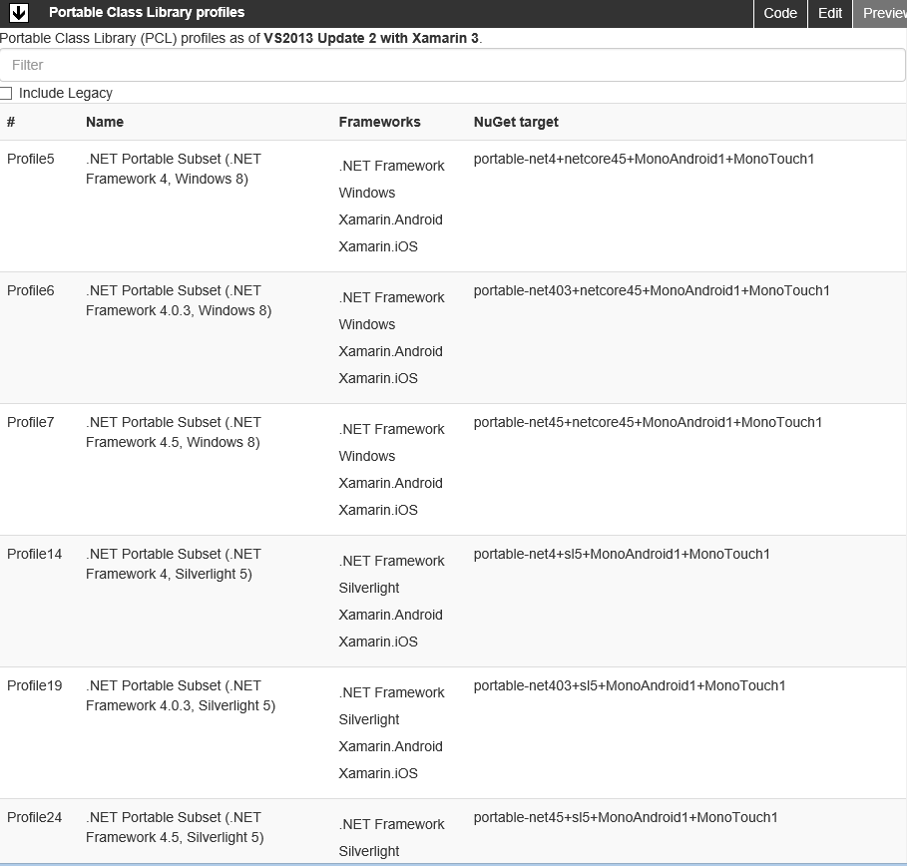
PCL Profile
http://blog.stephencleary.com/2012/05/framework-profiles-in-net.html

Slide 26
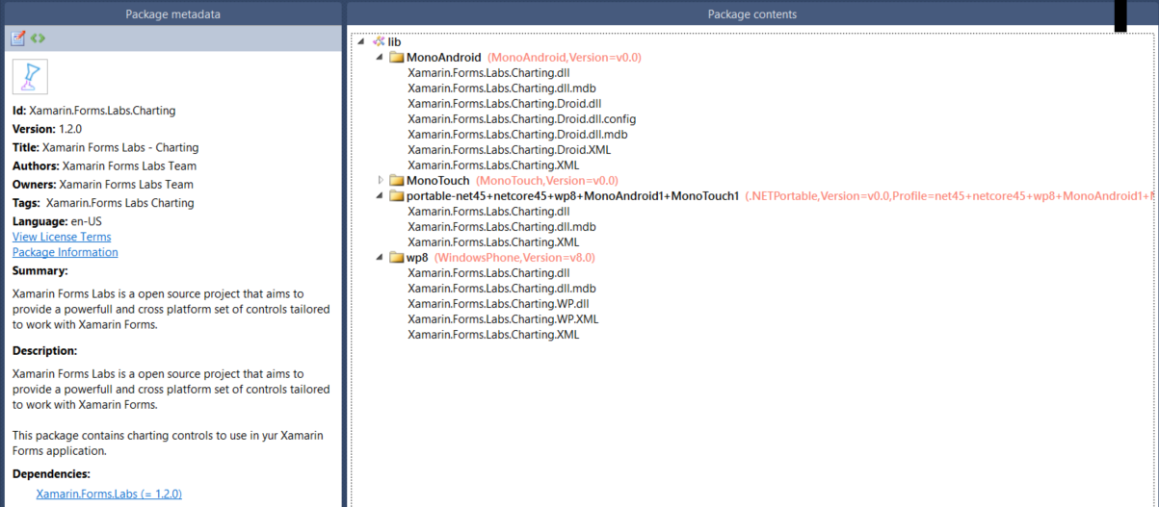
Anatomy of a Nuget Package

Slide 27
Shared Project vs. PCL
 | Shared Project | PCL
Public library (nuget deployment) |  | X
Multiple platforms in same logical application | X
Corporate application building block library |  | X
Current solution uses file linking and you want to simplify | X

Slide 28
Single Logical App – Multiple Platforms
iOS
Android
Windows Universal
Web Site
UI Shared
Business Logic Shared
View Models
Views
Models
Data Access

Slide 29
Reusable Library – Multiple Platforms
iOS
Android
Windows Universal
iOS
Android
Windows Universal
iOS DLL
Android DLL
Windows DLL
PCL
Implementation Classes
Implementation Classes
Implementation Classes
Interfaces
Models / DAL / Utilities

Slide 30
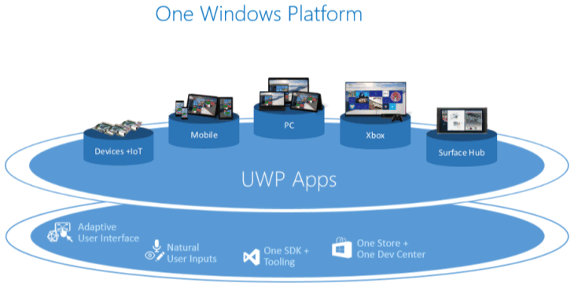
Universal Windows Apps

Slide 31
Frameworks
“Avoid pods at all costs …”
- Anonymous iOS Developer
Notes:
Some level of frameworks is good
Each brings in its own level of complexity – be careful how much you bring it

Slide 32

MVVM Frameworks

Slide 33
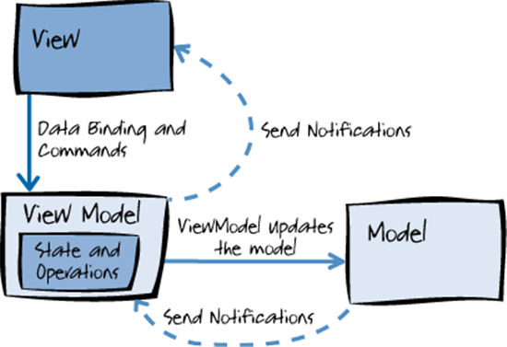
MVVM

Slide 34
Code Sharing and MVVM
Combination of tools and frameworks make this possible
View Models can be shared across multiple platforms
Windows Store
Windows Phone
Android
iOS
Similar techniques can be used with models and frameworks like CSLA

Slide 35
Demo: Taking a look at MVVM Cross

Slide 36
Key Points
Platforms, user expectations and skillsets may all impact code sharing strategy
Consider not just the platforms you are using today, but what you may need tomorrow
Arrange your project in such a way that your shared logic is both maintainable and extensible

Slide 37
Helpful Links
PCL Profiles - http://embed.plnkr.co/03ck2dCtnJogBKHJ9EjY/preview
PCL Profiles compatible with Xamarin - http://blog.stephencleary.com/2012/05/framework-profiles-in-net.html
Universal Windows Apps - https://msdn.microsoft.com/en-us/library/windows/apps/dn726767.aspx
MVVMCross - https://github.com/MvvmCross/MvvmCross
MVVMLight - http://www.mvvmlight.net/
Sample Code: https://github.com/Bowman74/VSLiveCodeSharing.git

Slide 38
Thank you!
Kevin Ford
Twitter: @Bowman74
kevinf@magenic.com
http://windingroadway.blogspot.com

Slide 39
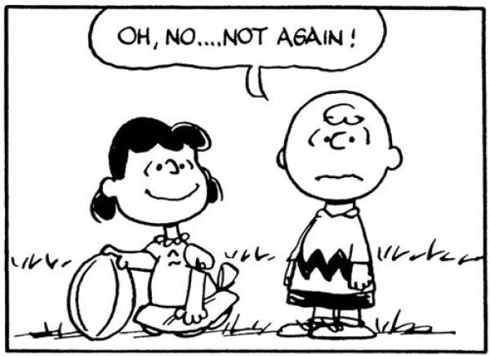
Bait and Switch

Slide 40
Bait and Switch
Demo - Creating your own nuget repository and implementing bait and switch

Slide 41

Selecting Packages

Slide 42
Universal???
Universal app – an app made to run on the iPad and iPhone
Universal Windows app – an app made to run on Windows 8.1 (Windows Store Applications) and Windows Phone
Unified API – An API to write code that can run on iOS and OSX
Android apps are “universal” in that they can work on phones and tablets

